Slide 1

CRICKET DATA ANALYSYS
DATA SCIENCE(DAV)

Slide 2
TEAM DETAILS
Name: Harshitha P S
Cranes Reg No.: I202310264097181
College Name: HKBK College of Engineering
Batch No. : INTDM07
Name: Kavya R Naik
Cranes Reg No.: 1202310264101185
College Name: HKBK College of Engineering
Batch No. : INTDM07
Project title: Cricket Data Analysis
Trainer Name: Sir. Hemesh Muniraju

Slide 3
DETAILS OF THE PROJECT
Topic: Crickect Data Analysis
Platform Used: Google Collab
Language Used: Python
Packages Used: NumPy, Pandas, Matplotlib, Seaborn
Dataset Used: Batting Data, Bowling Data
File Format Used: CSV(Comma Seperated Values) File

Slide 4

ABSTRACT
Cricket is a popular bat-and-ball game played between two teams, typically consisting of eleven players each. The game is widely followed and played in many countries, with international competitions such as the Cricket World Cup and various domestic leagues garnering significant attention.
Cricket has a rich history and a passionate global fan base.
The team batting tries to score runs, while the bowling team aims to dismiss the batsmen and restrict the runs scored.

Slide 5
Abstract Contd….
Batsmen score runs by hitting the ball and running between wickets. Runs are also scored when the ball crosses the boundary.
Bowlers aim to dismiss batsmen by getting them out through various means, such as getting them bowled, caught, or leg before wicket (LBW).
The game is played in sets of six deliveries called overs. The number of overs in a match can vary.
Cricket is played in different formats, including Test matches (longest format), One Day Internationals (ODIs), and Twenty20 (T20) matches, each with varying rules and durations.
One of the most significant areas where data analytics has been used in cricket is in player selection. Teams use data to identify players with the skills and abilities needed for specific roles in the team.

Slide 6

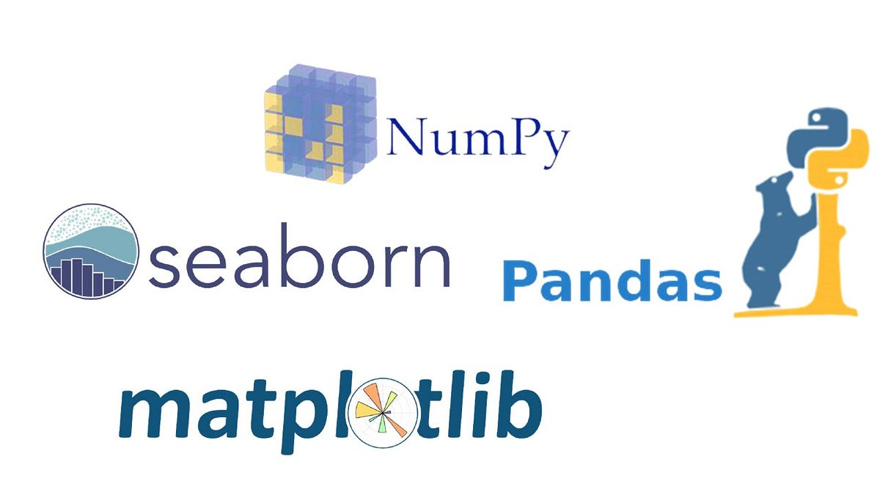
PACKAGES USED :-
We will be analysing and visualizing the data using the python libraries such as numpy, matplotlib, pandas, seaborn.

Slide 7

NUMPY
NumPy is a Python package.
It stands for “NUMERICAL PYTHON”.
Using NumPy, a developer can perform the following operations-
Mathematical and logical operations on arrays.
Fourier transforms and routines for shape manipulation.
Operations related to linear algebra.
NumPy has in-built functions for linear algebra and random number generation.

Slide 8
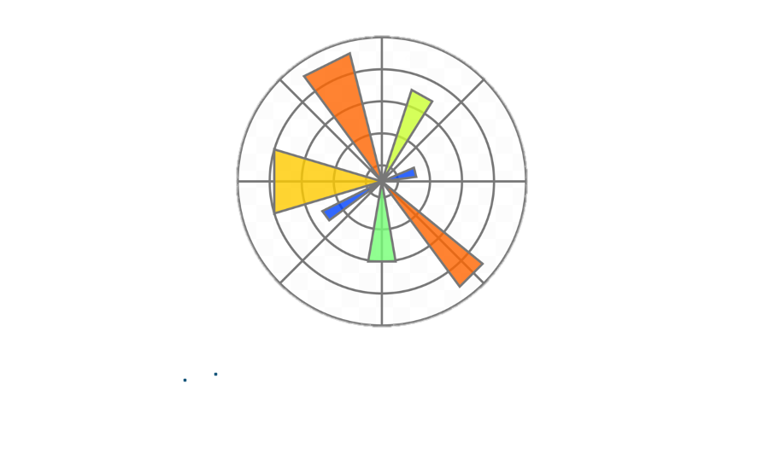
MATPLOTLIB
Matplotlib is a low level graph plotting library in python that serves as a visualization utility.
Types of matplotlib:
Matplotlib Line Plot
Matplotlib bar Plot
Matplotlib Histograms Plot
Matplotlib Scatter Plot
Matplotlib Pie Plot
Matplotlib Area Plot
MATPLOTLIB

Slide 9

PANDAS
Pandas is a Python library used for working with data sets.
It has functions for analyzing, cleaning, exploring, and manipulating data.
The name "Pandas" has a reference to both "Panel Data", and "Python Data Analysis“
Pandas allows us to analyze big data and make conclusions based on statistical theories.
Pandas can clean messy data sets, and make them readable and relevant.
Relevant data is very important in data science.

Slide 10


CRICKET BATTING DATASET
Batting dataset of World Cup 2023 contains the following data's:
1. Player names
2. Dismissal
3. Total of runs
4. Total no of balls faced
5. Total no of minutes played
6. No of 4's and 6's
7. Strike rate
8. Team the player belongs to
9. Opponent team
10. Innings

Slide 11

CRICKET BOWLING DATASET
Bowling dataset of World Cup 2023 contains the following data's:
1. Player names
2. Overs
3. Maidens
4. Number of runs
5. Total number of wickets
6. Run Rate
7. Number of 0’s,4's,6's
8. Number of wd’s, nb’s
9. Team names
10. Opponents team name
11. Innings

Slide 12

DATA ANALYSIS
Import the python libraries
Read the dataset using pandas:
1. If the dataset is .csv file: "pd.read_csv" is used
2. If the dataset is .xlsx file: "pd.read_excel" is used
3. If the dataset is .json file: "pd.read_json" is used
The df.column is used to extract the column names in the dataset
The df.shape specifies the number of rows and columns in the dataset
The df.value_counts() used to count the occurrences of unique values in a series/dataset.
The df.head() method in pandas is used to display the first few rows of a dataframe. By default, it shows the first 5 rows, but you we specify the number of rows we want to display within the parentheses.

Slide 13
The df.tail() method in pandas is used to display the last few rows of a dataframe. By default, it shows the last 5 rows, but we can specify the number of rows we want to display within the parentheses.
The df.dtypes is an attribute in pandas is used to return a series with the data type of each column in the dataframe.
The df.info() method in pandas provides a concise summary of a dataframe, including the data types, non-null values, and memory usage. It's a useful tool for quickly understanding the structure and characteristics of our dataframe.
The sort_values() method in pandas to sort a dataframe based on a specific column in ascending or descending order.
We can access the rows using indexing and columns using their respective names. Eg: df["player"]

Slide 14
If more than one column to be printed or displayed, pass the column names inside the subscript bracket of the dataset.
Eg: df[["player","strike_rate","runs"]]
Filtering the dataframe or analysing the dataframe based on some conditions
Eg:df[(df["6s"]>=5) & (df["4s"]>=5) & (df["team"]=="India") ]
Here we are filtering the data based on the the number of 6s is greater than or equal to 5, the number of 4s is greater than or equal to 5, and the team is "India".
Similarly we analyze/filter for different columns

Slide 15

DATA VISUALISATION-BAR GRAPHS
We visualize the data using bar graphs, pie charts, scatter plot.
For constructing a bar graph use plt.bar() passing the parameters "x axis","y axis", color,width,etc
Initialize the width and height of the bar graph using the plt.figure()
Eg:fig=plt.figure(figsize=(10,10))
The plt.xlabel is used to label the x axis.
The plt.ylabel is used to label the y axis.
The plt.title is used to provide title to the bar graph.
The plt.show() is used to display the bar graph.
We sort our dataset based on a column, store it in an object, use this dataset to visualize.
Using the bar graph, we analyse the the top performers among the list of players and many more

Slide 16
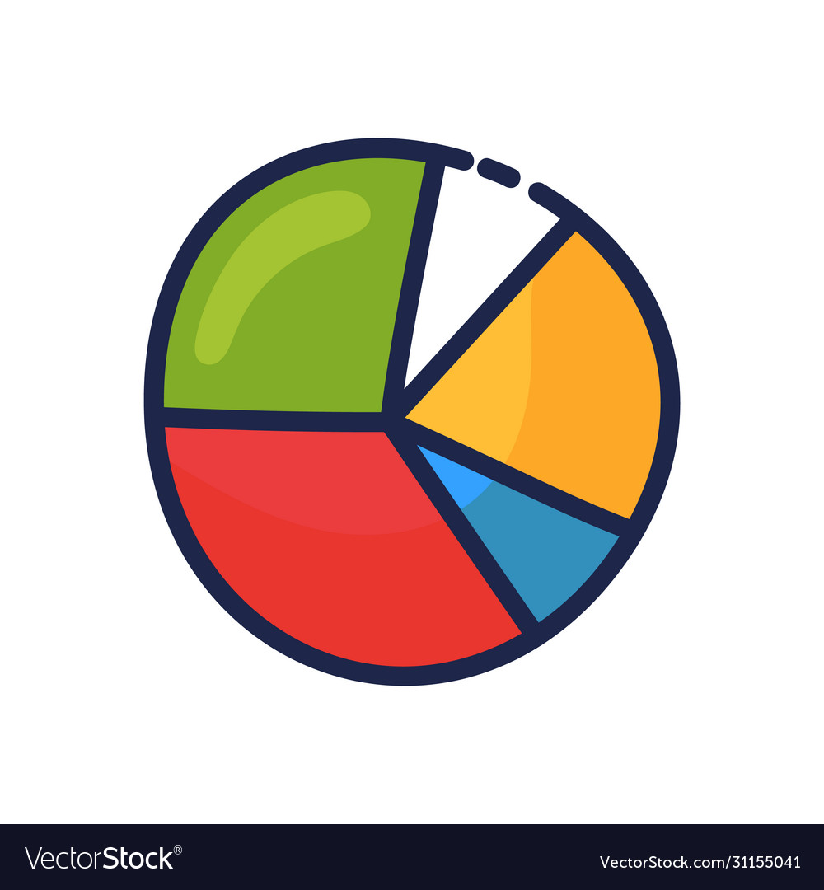
DATA VISUALISATION-PIE CHART
For constructing a pie chart use plt.pie() passing the parameters such as datasets,labels,autopct,etc
A dictionary is being used where some of the data is extracted from the source dataset and stored in it(dictionary) using the for loop(itertuples) ,in form of key-value pairs.
Using the dictionary data, we construct a pie chart to analyze the statistics of each player and many more .

Slide 17
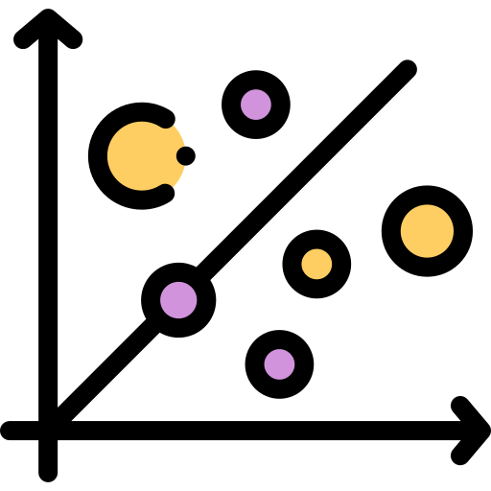
SEABORN
Seaborn is a statistical data visualization library based on Matplotlib. It provides a high-level interface for drawing attractive and informative statistical graphics. We can use it to create a variety of plots, such as scatter plots, bar plots, box plots, and more.
The groupby() function is used which is part of the Pandas library and is used for grouping data based on some criteria.
Eg: team_group=df.groupby("team")
Here we are grouping our dataset based on the teams and storing it in an object.
These object datasets are used to plot a scatter plot.

Slide 18
CONCLUSION
Data science goes a long way in suggesting optimal strategies for a team to win a match. It also provides sufficient information for a franchise to bid on players. Today, there is an influx of cricket statistics-oriented websites and organizations that provide detailed information on cricket.
Data analytics can help solve the uncertainty attached to a bowler or a batsman’s average performance. What’s critical is to know how they will perform in a given circumstance. Collectively, all of this data has the potential to create vast opportunities to analyse and draw meaningful insights, which then help predict or classify future events.

